Slide 1
Network Programing Term project
20142209 서 현성
20142210 손 동현
20142212 손 종익

Slide 2
Agenda
Server
Client
구현 영상
Made by SJI

Slide 3

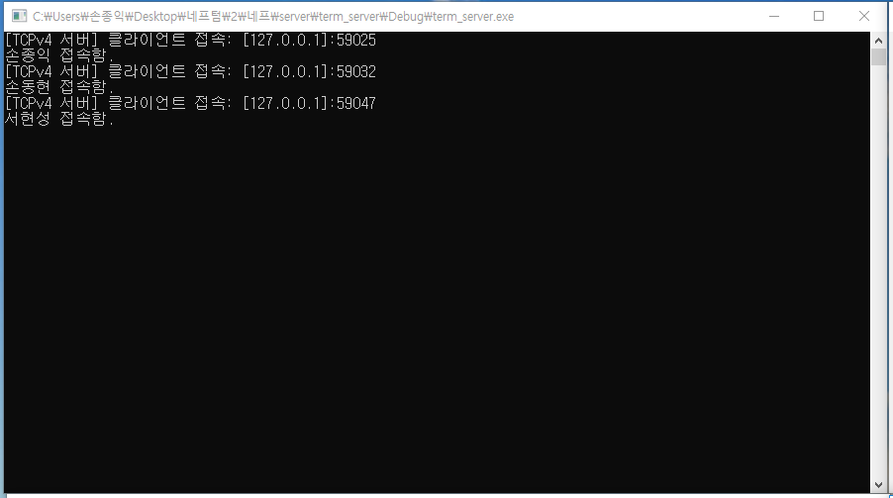
Server
접속한 리스트
retval = recv(client_sock, usr_name, sizeof(usr_name), 0);
printf("%s 접속함.\n", usr_name);
AddSocketInfo(client_sock, false, usr_name);
//접속한 유저이름을 접속자 리스트로 전송
hThread = CreateThread(NULL, 0, SendUserList, NULL, 0, NULL);
Made by SJI

Slide 4
Server
접속자 리스트 보내기
//실시간 유저정보 보내기
DWORD WINAPI SendUserList(LPVOID arg) {
int retval;
int k,h;
for (k = 0; k < nTotalSockets; k++) {
COMM_MSG comm_msg;
SOCKETINFO *ptr = SocketInfoArray[k];
comm_msg.type = 900;
for (h = 0; h < nTotalSockets; h++) {
SOCKETINFO *ptr3 = SocketInfoArray[h];
retval = send(ptr->sock, (char *)&comm_msg, sizeof(COMM_MSG), 0);
if (retval == SOCKET_ERROR) {
err_display("send()");
RemoveSocketInfo(k);
continue;
}
Made by SJI

Slide 5
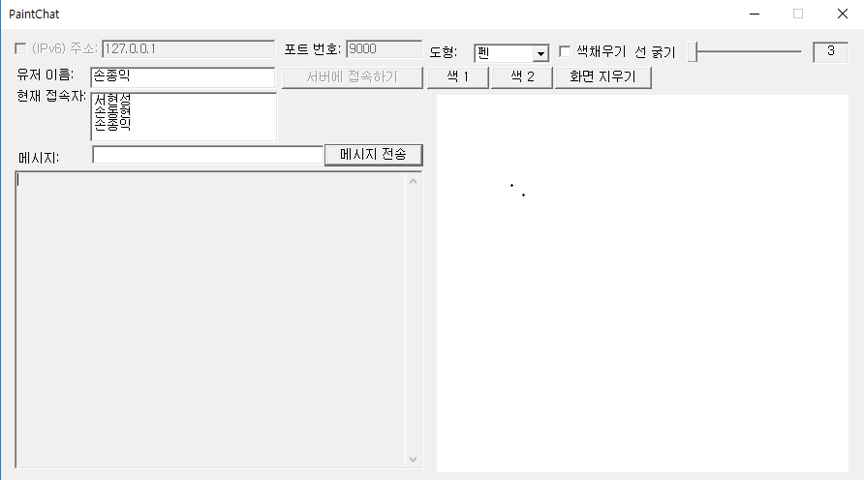
Server
접속자 리스트 보내기
itoa(nTotalSockets, buf, radix);
retval = send(ptr->sock,buf,sizeof(buf), 0);
if (retval == SOCKET_ERROR) {
err_display("send()");
}
retval = send(ptr->sock,ptr3->username, 15, 0);
if (retval == SOCKET_ERROR) {
err_display("send()");
RemoveSocketInfo(h);
--h; // 루프 인덱스 보정
continue;
}
}
}
Sleep(500);
return 0;
}
Made by SJI

Slide 6
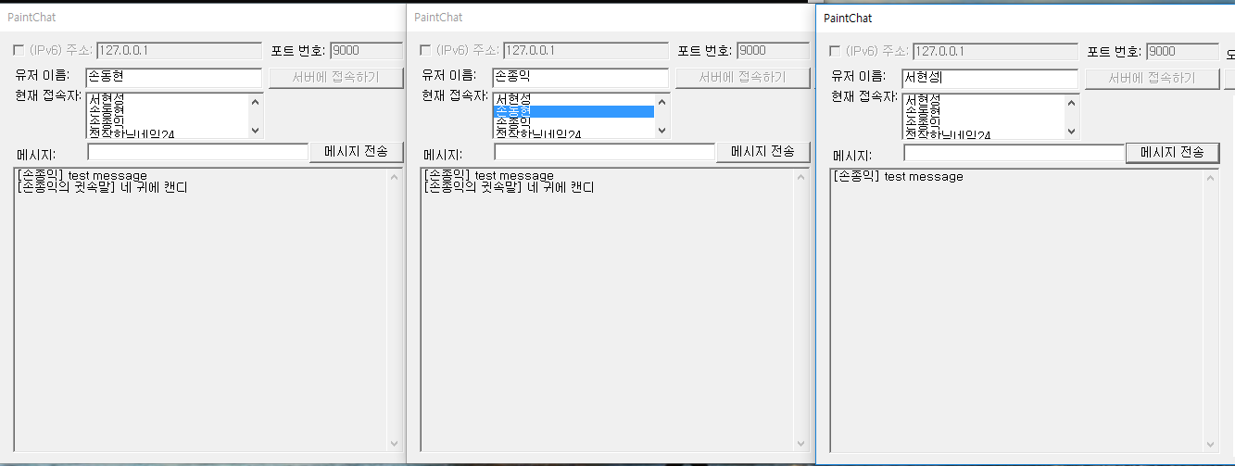
Server
데이터 통신(귓속말)
//귓속말 모드
if (comm_msg.type == 999)
{
if (i == j || j==comm_msg.index)
{
retval = send(ptr2->sock, (char *)&comm_msg, sizeof(COMM_MSG), 0);
if (retval == SOCKET_ERROR)
{
err_display("send()");
RemoveSocketInfo(i);
continue;
}
}
Made by SJI

Slide 7
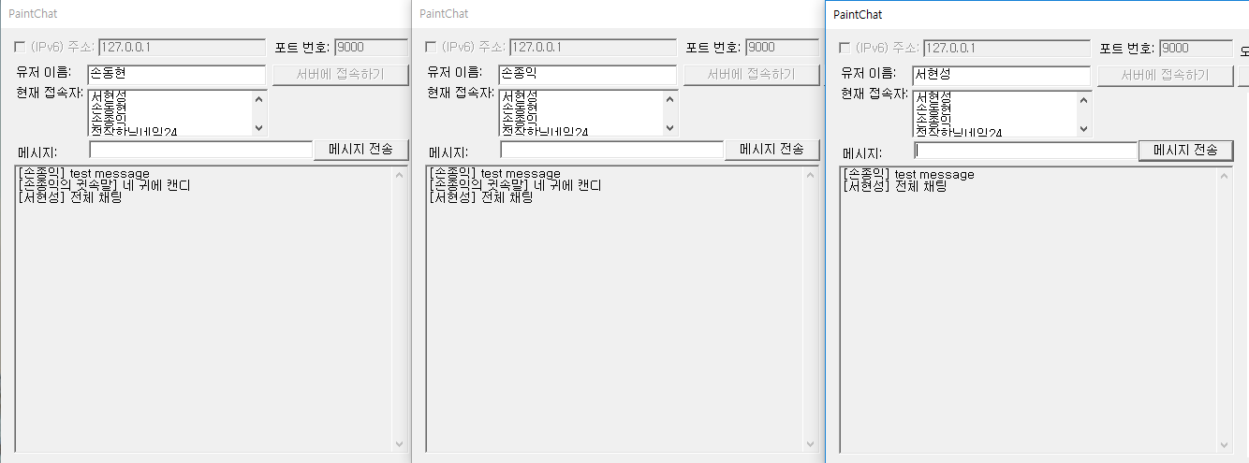
Server
데이터 통신(전체 채팅)
//전체채팅 모드
else if (comm_msg.type == 1000)
{
retval = send(ptr2->sock, (char *)&comm_msg, sizeof(COMM_MSG), 0);
if (retval == SOCKET_ERROR)
{
err_display("send()");
RemoveSocketInfo(i);
continue;
}
Made by SJI

Slide 8
Server
데이터 통신(공통)
//이름보내기
retval = send(ptr2->sock, ptr->username, 15, 0);
if (retval == SOCKET_ERROR)
{
err_display("send()");
RemoveSocketInfo(j);
--j; // 루프 인덱스 보정
continue;
}
//내용 보내기
retval = send(ptr2->sock, ptr->buf, comm_msg.size, 0);
if (retval == SOCKET_ERROR)
{
err_display("send()");
RemoveSocketInfo(i);
continue;
}
Made by SJI

Slide 9
Server
채팅 타입 지정
//채팅 타입 지정
else if (comm_msg.type == 901)
{
NIGHTBOT_MSG n_msg;
retval = send(ptr2->sock, (char *)&comm_msg, sizeof(COMM_MSG), 0);
if (retval == SOCKET_ERROR)
{
err_display("send()");
RemoveSocketInfo(i);
continue;
}
//내용 보내기
strcpy(n_msg.servername, "server");
retval = send(ptr2->sock, n_msg.servername, 15, 0);
if (retval == SOCKET_ERROR){
err_display("send()");
RemoveSocketInfo(i);
continue;
}
Made by SJI

Slide 10
Server
채팅 타입 지정
//현재 시간
if (!strcmp(ptr->buf, "!time")) {
CurrentTime();
strcpy(n_msg.buf, current_time);
retval = send(ptr2->sock, n_msg.buf, comm_msg.size, 0);
if (retval == SOCKET_ERROR) {
err_display("send()");
RemoveSocketInfo(i);
continue;
}
}
else {
strcpy(n_msg.buf, "없는 명령");
retval = send(ptr2->sock, n_msg.buf, comm_msg.size, 0);
if (retval == SOCKET_ERROR) {
err_display("send()");
RemoveSocketInfo(i);
continue;
}
Made by SJI

Slide 11
Server
채팅 타입 지정
else { //나머지 타입
retval = send(ptr2->sock, (char *)&comm_msg, sizeof(COMM_MSG), 0);
if (retval == SOCKET_ERROR) {
err_display("send()");
RemoveSocketInfo(i);
continue;
}
retval = send(ptr2->sock, ptr->username, 15, 0);
if (retval == SOCKET_ERROR) {
err_display("send()");
RemoveSocketInfo(j);
--j; // 루프 인덱스 보정
continue;
}
retval = send(ptr2->sock, ptr->buf, comm_msg.size, 0);
if (retval == SOCKET_ERROR) {
err_display("send()");
RemoveSocketInfo(i);
continue;}
Made by SJI

Slide 12
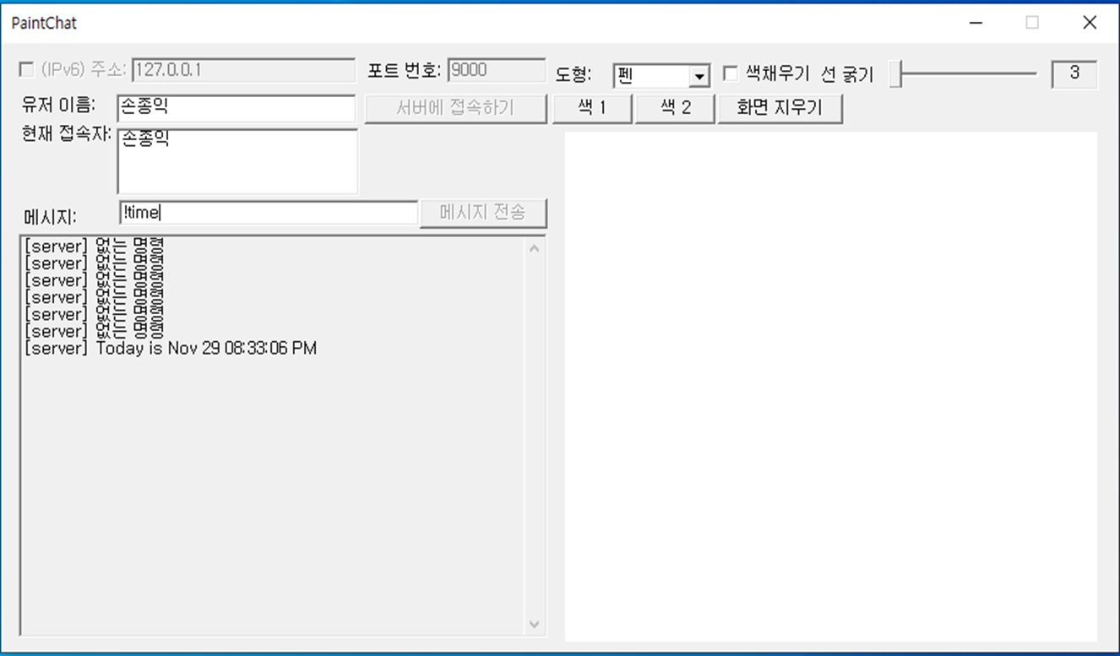
Server
현재 시간 구하기
//현재시간 구하기
void CurrentTime()
{
int rc;
time_t temp;
struct tm *timeptr;
temp = time(NULL);
timeptr = localtime(&temp);
rc = strftime(current_time, sizeof(current_time), "Today is %b %d %r", timeptr);
}
Made by SJI

Slide 13
Client
컨트롤 핸들
case WM_INITDIALOG:
// 컨트롤 핸들 얻기
hButtonIsIPv6 = GetDlgItem(hDlg, IDC_ISIPV6);
hEditIPaddr = GetDlgItem(hDlg, IDC_IPADDR);
hEditPort = GetDlgItem(hDlg, IDC_PORT);
hButtonConnect = GetDlgItem(hDlg, IDC_CONNECT);
g_hButtonSendMsg = GetDlgItem(hDlg, IDC_SENDMSG);
hUserID = GetDlgItem(hDlg, IDC_USERNAME);//유저 ID 입력
hUserList = GetDlgItem(hDlg, IDC_USERLIST);//현재 접속 유저 리스트
hEditMsg = GetDlgItem(hDlg, IDC_MSG);
g_hEditStatus = GetDlgItem(hDlg, IDC_STATUS);
hShapeCombo = GetDlgItem(hDlg, IDC_COMBO_SHAPE);//
hColorButton = GetDlgItem(hDlg, IDC_COLORBUTTON);// 색 선택 버튼
hLineWidthSlider = GetDlgItem(hDlg, IDC_LINEWIDTH);// 선 굵기 슬라이더
g_hShapeFill = GetDlgItem(hDlg, IDC_ISFILL_CHECK); // 색 채우기 체크 박스
hWidth = GetDlgItem(hDlg, IDC_DISWIDTH);
hClear = GetDlgItem(hDlg, IDC_CLEAR);
Made by SJI

Slide 14
Client
컨트롤 핸들 초기화
SendMessage(hEditMsg, EM_SETLIMITTEXT, MSGSIZE, 0);
EnableWindow(g_hButtonSendMsg, FALSE);
SetDlgItemText(hDlg, IDC_IPADDR, SERVERIPV4);
SetDlgItemText(hDlg, IDC_USERNAME, NULL);
SetDlgItemInt(hDlg, IDC_PORT, SERVERPORT, FALSE);
SendMessage(hLineWidthSlider, TBM_SETRANGE, (WPARAM)1, (LPARAM)MAKELONG(1, 100));
SendMessage(hShapeCombo, CB_ADDSTRING, 0, (LPARAM)"펜");
SendMessage(hShapeCombo, CB_ADDSTRING, 0, (LPARAM)"삼각형");
SendMessage(hShapeCombo, CB_ADDSTRING, 0, (LPARAM)"사각형");
SendMessage(hShapeCombo, CB_ADDSTRING, 0, (LPARAM)"원형");
SendMessage(hShapeCombo, CB_ADDSTRING, 0, (LPARAM)"직선");
SendMessage(hShapeCombo, CB_ADDSTRING, 0, (LPARAM)"직각 삼각형");
SendMessage(hShapeCombo, CB_ADDSTRING, 0, (LPARAM)"마름모");
SendMessage(hShapeCombo, CB_ADDSTRING, 0, (LPARAM)"육각형");
SendMessage(hShapeCombo, CB_ADDSTRING, 0, (LPARAM)"별");
SendMessage(hShapeCombo, CB_ADDSTRING, 0, (LPARAM)"지우개");
SendMessage(hShapeCombo, CB_SETCURSEL, 0, (LPARAM)"펜");
SetDlgItemInt(hDlg, IDC_DISWIDTH, 3, FALSE);
EnableWindow(g_hClear, TRUE);
EnableWindow(g_RColor, TRUE);
Made by SJI

Slide 15
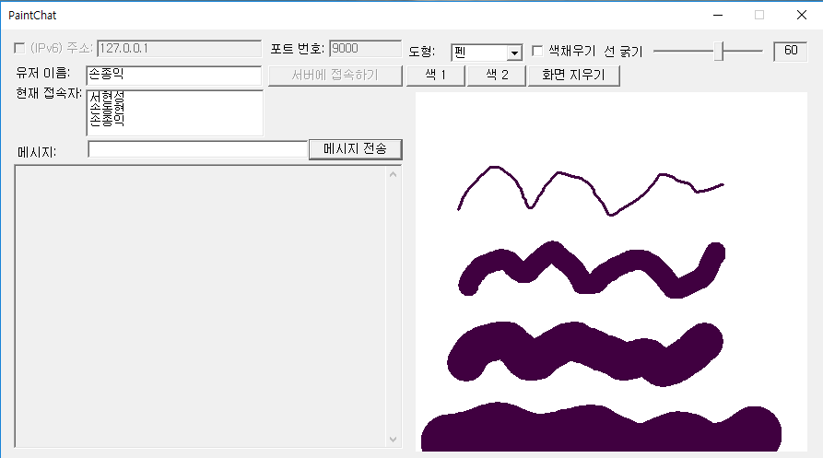
Client
선 굵기 조절
case WM_HSCROLL:
g_drawmsg.lineWidth = SendDlgItemMessage(hDlg, IDC_LINEWIDTH, TBM_GETPOS, 0, 0);
SetDlgItemInt(hDlg, IDC_DISWIDTH, g_drawmsg.lineWidth, FALSE);
return 0;
Made by SJI

Slide 16
Client
콤보 박스
case IDC_COMBO_SHAPE:// 모양 combobox 선택할 때
switch (ComboBox_GetCurSel(hShapeCombo)){
case 0:
g_drawmsg.type = DRAWLINE;
EnableWindow(g_hShapeFill, TRUE);
break;
case 1:
g_drawmsg.type = DRAWTRI;
EnableWindow(g_hShapeFill, TRUE);
break;
case 2:
g_drawmsg.type = DRAWRECT;
EnableWindow(g_hShapeFill, TRUE);
break;
case 3:
g_drawmsg.type = DRAWELLIPSE;
EnableWindow(g_hShapeFill, TRUE);
break;
case 4:
g_drawmsg.type = DRAWSTRICTLINE;
EnableWindow(g_hShapeFill, TRUE);
break;
Made by SJI

Slide 17
Client
콤보 박스
case 5:
g_drawmsg.type = DRAWRIGHTTRI;
SendMessage(g_hShapeFill, BM_SETCHECK, BST_UNCHECKED, 0);
EnableWindow(g_hShapeFill, FALSE);
break;
case 6:
g_drawmsg.type = DRAWRHOMBUS;
SendMessage(g_hShapeFill, BM_SETCHECK, BST_UNCHECKED, 0);
EnableWindow(g_hShapeFill, FALSE);
break;
case 7:
g_drawmsg.type = DRAWHEXAGON;
SendMessage(g_hShapeFill, BM_SETCHECK, BST_UNCHECKED, 0);
EnableWindow(g_hShapeFill, FALSE);
break;
Made by SJI

Slide 18
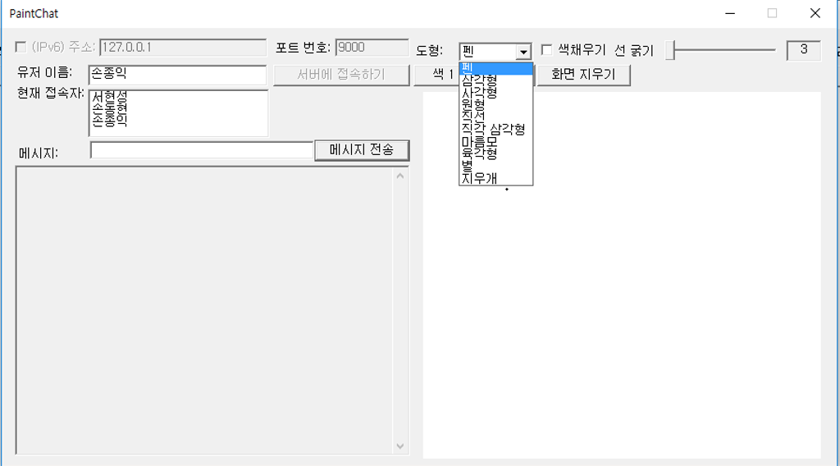
Client
콤보 박스
case 8:
g_drawmsg.type = DRAWSTAR;
SendMessage(g_hShapeFill, BM_SETCHECK, BST_UNCHECKED, 0);
EnableWindow(g_hShapeFill, FALSE);
break;
case 9:
g_drawmsg.type = DRAWERASER;
EnableWindow(g_hShapeFill, TRUE);
break;
default:
g_drawmsg.type = DRAWLINE;
break;
}
Made by SJI

Slide 19

Client
유저 리스트
case WM_ADDUSER:
{
SendMessage(hUserList, LB_ADDSTRING, 0, (LPARAM)lParam);
count++;
if (count == listNum) {
USERLIST_FLAG = 0;
count = 0;
}
return TRUE;
}
case WM_RESETUSER:
{
SendMessage(hUserList, LB_RESETCONTENT, 0, (LPARAM)lParam);
return TRUE;
}
Made by SJI

Slide 20
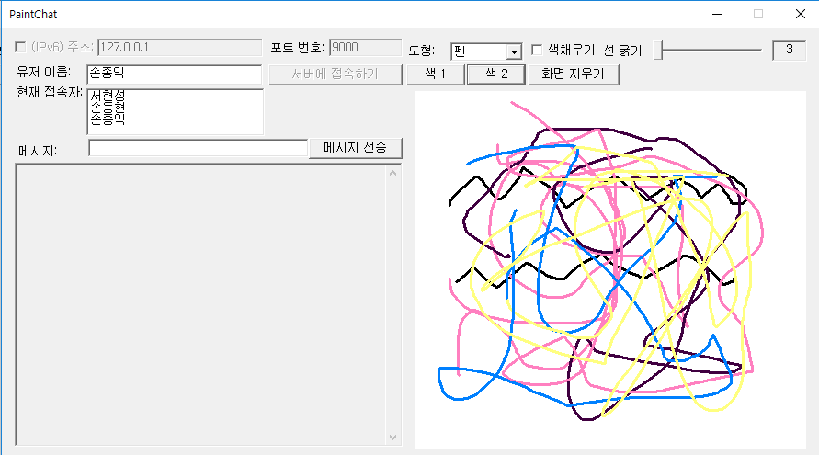
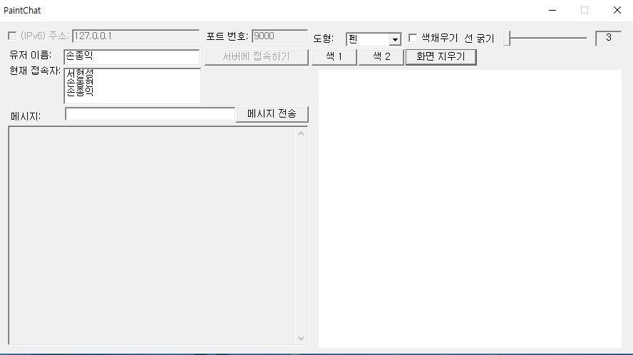
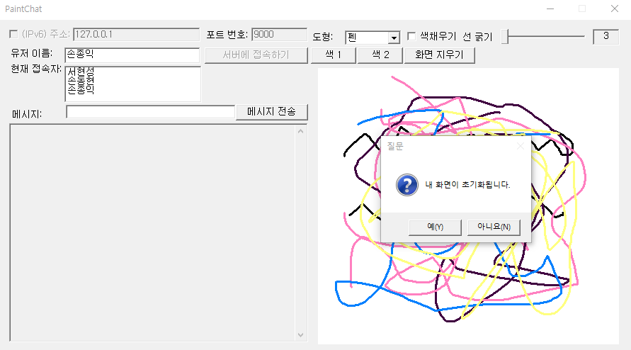
Client
화면 지우기
case IDC_CLEAR:
if(MessageBox(hDlg,"내 화면이 초기화됩니다.","질문",MB_YESNO | MB_ICONQUESTION) == IDYES)
{
childWndInit(hDlg);
}
return TRUE;
Made by SJI

Slide 21
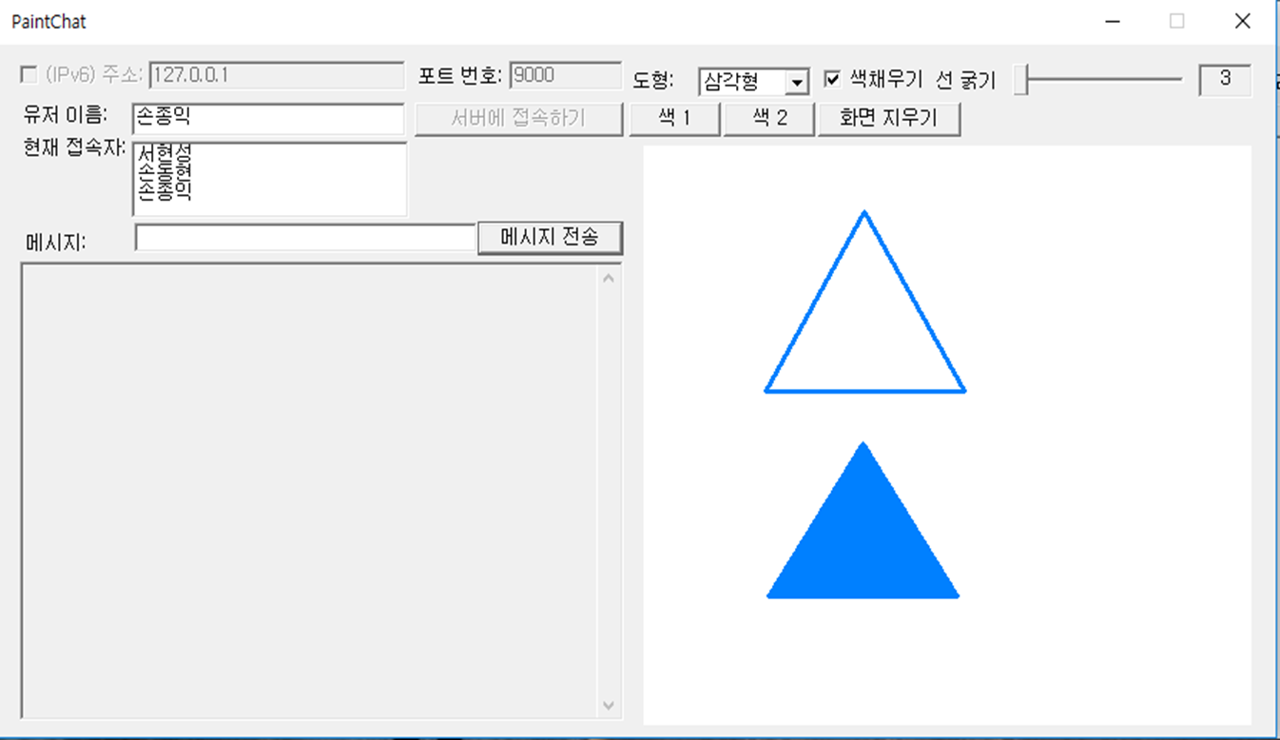
Client
색 채우기
case IDC_ISFILL_CHECK:
g_drawmsg.isFill = SendMessage(g_hShapeFill, BM_GETCHECK, 0, 0);
return TRUE;
Made by SJI

Slide 22
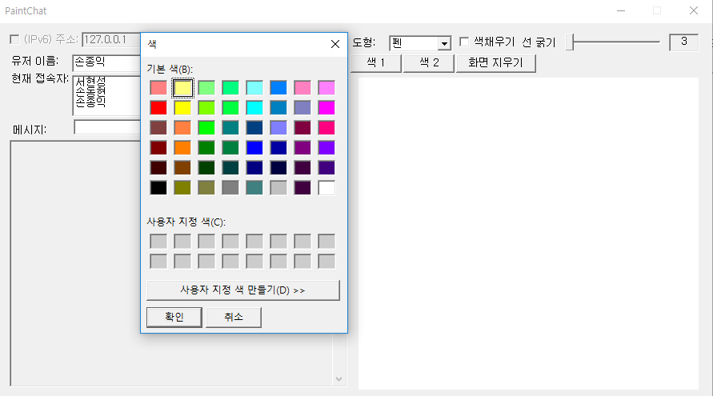
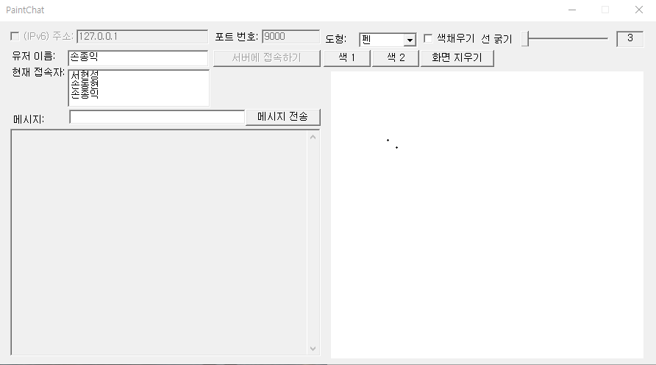
Client
마우스 왼쪽 버튼
case IDC_COLORBUTTON:
memset(&COLOR, 0, sizeof(CHOOSECOLOR));
COLOR.lStructSize = sizeof(CHOOSECOLOR);
COLOR.hwndOwner = hDlg;
COLOR.lpCustColors = crTmp;
COLOR.Flags = 0;
if (ChooseColor((LPCHOOSECOLORA)&COLOR) != 0) {
Color = COLOR.rgbResult;
InvalidateRect(hDlg, NULL, TRUE);
}
return TRUE;
Made by SJI

Slide 23
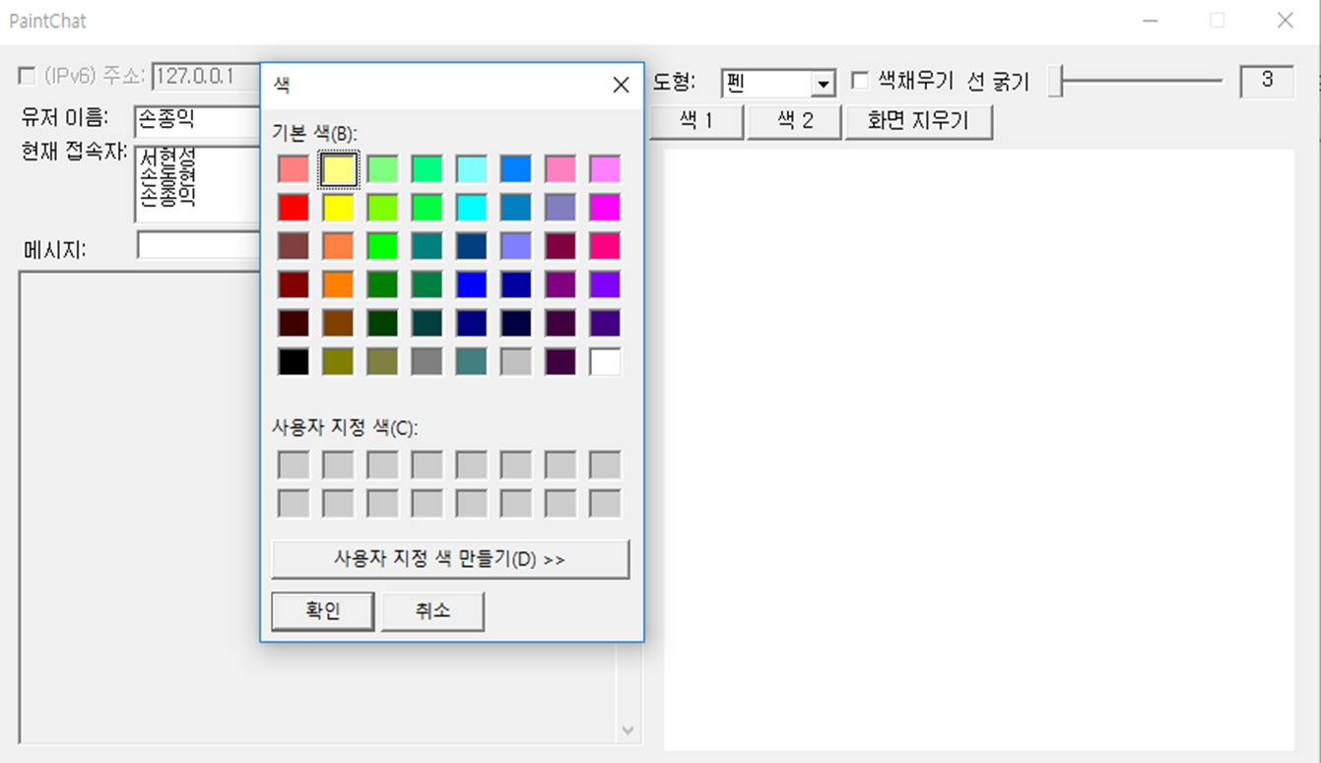
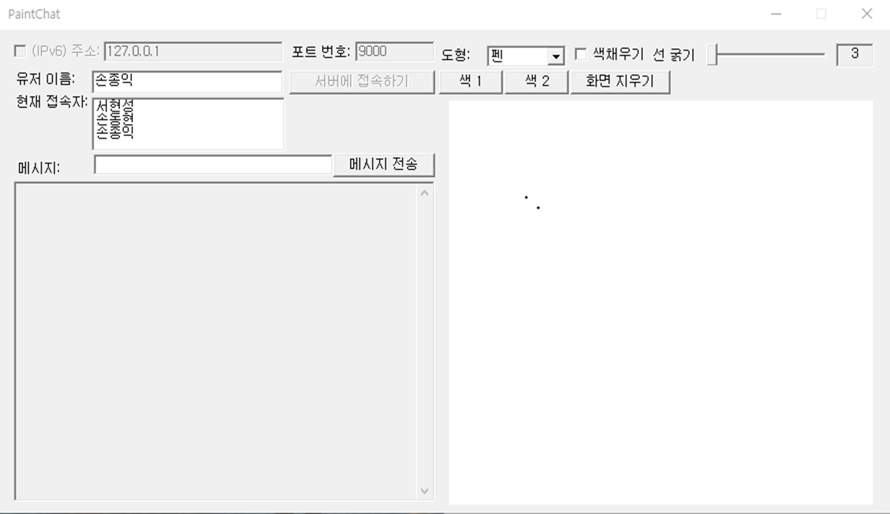
Client
마우스 오른쪽 버튼
case IDC_COLORBUTTON2:
memset(&COLOR, 0, sizeof(CHOOSECOLOR));
COLOR.lStructSize = sizeof(CHOOSECOLOR);
COLOR.hwndOwner = hDlg;
COLOR.lpCustColors = crTmp;
COLOR.Flags = 0;
if (ChooseColor((LPCHOOSECOLORA)& COLOR) != 0) {
RColor = COLOR.rgbResult;
InvalidateRect(hDlg, NULL, TRUE);
}
return TRUE;
Made by SJI

Slide 24

Client
나이트 봇
w_comm_msg.size = strlen(g_chatmsg.buf) + 1 + NAMESIZE + sizeof(int);
//나이트봇 기능
if (g_chatmsg.buf[0] == '!’)
{
SEND_NBOT_FLAG = 1;
w_comm_msg.type = NIGHTBOT;
}
else
{
w_comm_msg.type = g_chatmsg.type;
}
Made by SJI

Slide 25
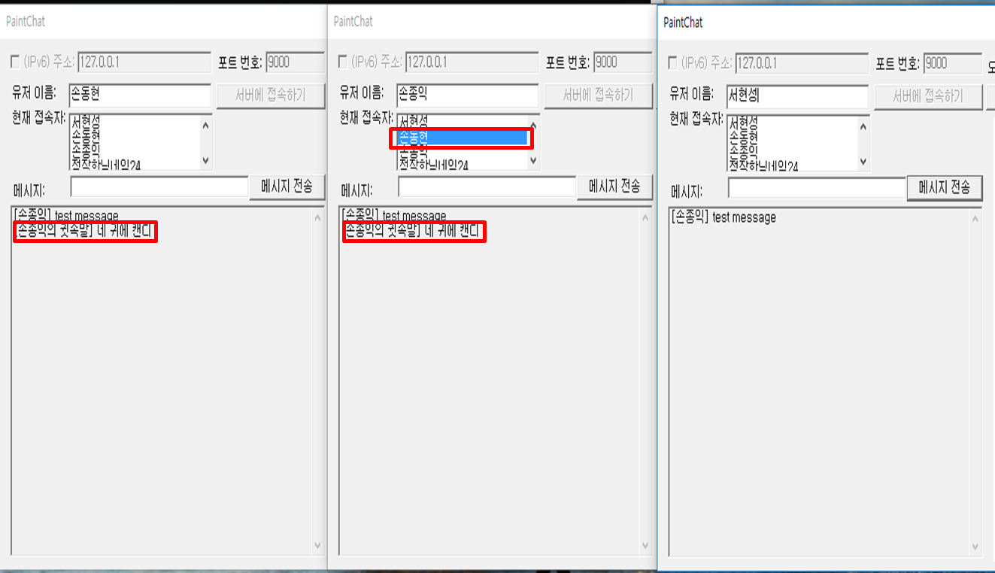
Client
귓속말
//유저 리스트 박스 선택시 해당 인덱스 값에 해당하는 유저에게 귓속말 전송
if (w_comm_msg.index != LB_ERR) { //LB_ERR = -1
w_comm_msg.type = WHISPER;
retval = send(g_sock, (char *)&w_comm_msg, sizeof(COMM_MSG), 0);
if (retval == SOCKET_ERROR) {
break;
}
if (w_comm_msg.type == NIGHTBOT) {
retval = send(g_sock, g_chatmsg.buf, w_comm_msg.size, 0);
if (retval == SOCKET_ERROR) {
break;
}
}
else {
retval = send(g_sock, (char *)&g_chatmsg, w_comm_msg.size, 0);
if (retval == SOCKET_ERROR) {
break;
}
}
}
Made by SJI

Slide 26

Client
삼각형
case DRAWTRI:
{
POINT trianglePoints[4] = { { LOWORD(lParam), HIWORD(lParam) }, { newLine->x0, HIWORD(lParam) }, {(LOWORD(lParam) - newLine->x0) / 2 + newLine->x0, newLine->y0 }, { LOWORD(lParam), HIWORD(lParam) } };
if (newLine->isFill)
{
LogBrush.lbColor = g_drawcolor;
LogBrush.lbHatch = HS_VERTICAL;
LogBrush.lbStyle = BS_SOLID;
HBRUSH brush = CreateBrushIndirect(&LogBrush);
SelectObject(hDC, brush);
}
else
{
SelectObject(hDC, GetStockObject(NULL_BRUSH));
}
Polygon(hDC, trianglePoints, 4);
break;
}
Made by SJI

Slide 27
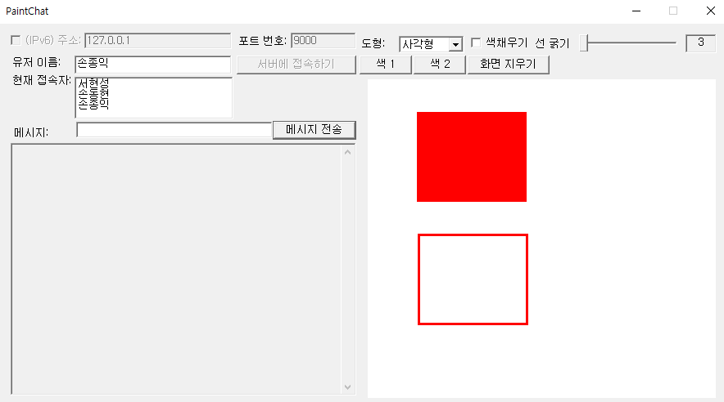
Client
사각형
case DRAWRECT:
if (newLine->isFill)
{
LogBrush.lbColor = g_drawcolor;
LogBrush.lbHatch = HS_VERTICAL;
LogBrush.lbStyle = BS_SOLID;
HBRUSH brush = CreateBrushIndirect(&LogBrush);
SelectObject(hDC, brush);
}
else
{
SelectObject(hDC, GetStockObject(NULL_BRUSH));
}
Rectangle(hDC, newLine->x0, newLine->y0, LOWORD(lParam), HIWORD(lParam));
break;
Made by SJI

Slide 28
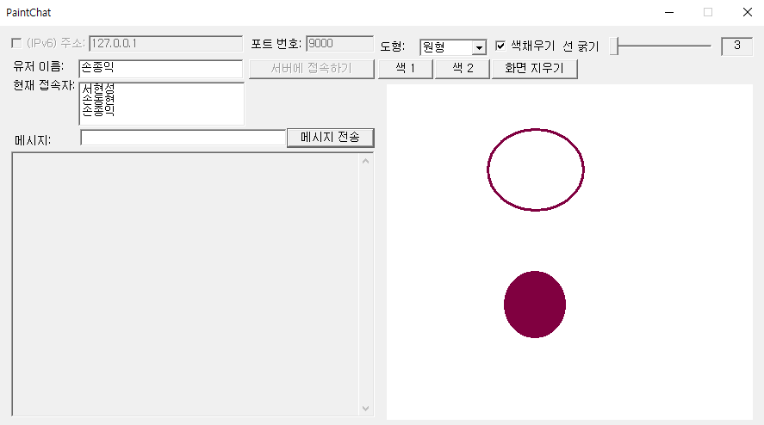
Client
타원
case DRAWELLIPSE:
{
if (newLine->isFill)
{
LogBrush.lbColor = g_drawcolor;
LogBrush.lbHatch = HS_VERTICAL;
LogBrush.lbStyle = BS_SOLID;
HBRUSH brush = CreateBrushIndirect(&LogBrush);
SelectObject(hDC, brush);
}
else
{
SelectObject(hDC, GetStockObject(NULL_BRUSH));
}
Ellipse(hDC, newLine->x0, newLine->y0, LOWORD(lParam), HIWORD(lParam));
break;
}
Made by SJI

Slide 29
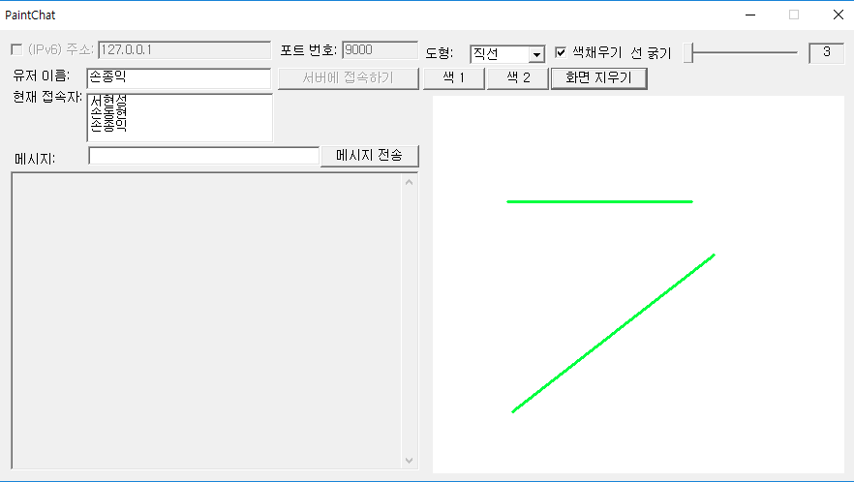
Client
직선
case DRAWSTRICTLINE:
{
MoveToEx(hDC, newLine->x0, newLine->y0, NULL);
LineTo(hDC, newLine->x1, newLine->y1);
break;
}
Made by SJI

Slide 30
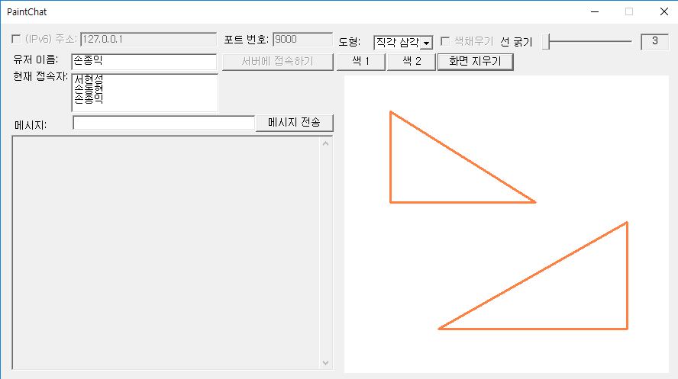
Client
직각 삼각형
case DRAWRIGHTTRI:
drawRightTri(hDC, newLine->x0, newLine->y0,LOWORD(lParam), HIWORD(lParam));
break;
void drawRightTri(HDC hDC, int x0, int y0, int x1, int y1)
{
MoveToEx(hDC, x0, y0, NULL);
LineTo(hDC, x1, y1);
MoveToEx(hDC, x1, y1, NULL);
LineTo(hDC, x0, y1);
MoveToEx(hDC, x0, y1, NULL);
LineTo(hDC, x0, y0);
}
Made by SJI

Slide 31
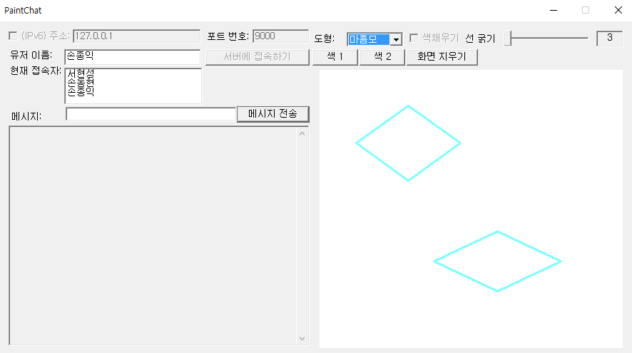
Client
마름모
case DRAWRHOMBUS:
drawRhombus(hDC, newLine->x0, newLine->y0, LOWORD(lParam), HIWORD(lParam));
break;
void drawRhombus(HDC hDC, int x0, int y0, int x1, int y1)
{
MoveToEx(hDC, (x0 + x1) / 2, y0, NULL);
LineTo(hDC, x0, (y0 + y1) / 2);
MoveToEx(hDC, x0, (y0 + y1) / 2, NULL);
LineTo(hDC, (x0 + x1) / 2, y1);
MoveToEx(hDC, (x0 + x1) / 2, y1, NULL);
LineTo(hDC, x1, (y1 + y0) / 2);
MoveToEx(hDC, x1, (y1 + y0) / 2, NULL);
LineTo(hDC, (x0 + x1) / 2, y0);
}
Made by SJI

Slide 32
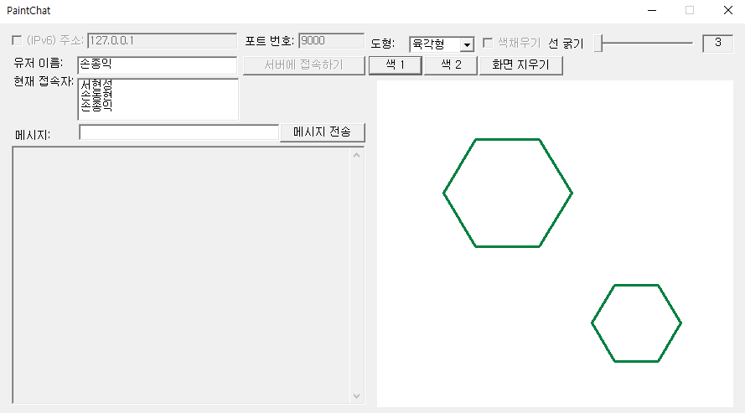
Client
육각형
case DRAWHEXAGON:
drawHexagon(hDC, newLine->x0, newLine->y0, LOWORD(lParam), HIWORD(lParam));
break;
void drawHexagon(HDC hDC, int x0, int y0, int x1, int y1)
{
MoveToEx(hDC, (unsigned int)((x0 + x1) / 2 - (x1 - x0) / 4), y0, NULL);
LineTo(hDC, (unsigned int)((x0 + x1) / 2 + (x1 - x0) / 4), y0);
MoveToEx(hDC, (unsigned int)((x0 + x1) / 2 - (x1 - x0) / 4), y1, NULL);
LineTo(hDC, (unsigned int)((x0 + x1) / 2 + (x1 - x0) / 4), y1);
MoveToEx(hDC, (unsigned int)((x0 + x1) / 2 - (x1 - x0) / 4), y0, NULL);
LineTo(hDC, x0, (unsigned int)((y0 + y1) / 2));
MoveToEx(hDC, (unsigned int)((x0 + x1) / 2 - (x1 - x0) / 4), y1, NULL);
LineTo(hDC, x0, (unsigned int)((y0 + y1) / 2));
MoveToEx(hDC, (unsigned int)((x0 + x1) / 2 + (x1 - x0) / 4), y0, NULL);
LineTo(hDC, x1, (unsigned int)((y0 + y1) / 2));
MoveToEx(hDC, (unsigned int)((x0 + x1) / 2 + (x1 - x0) / 4), y1, NULL);
LineTo(hDC, x1, (unsigned int)((y0 + y1) / 2));
}
Made by SJI

Slide 33
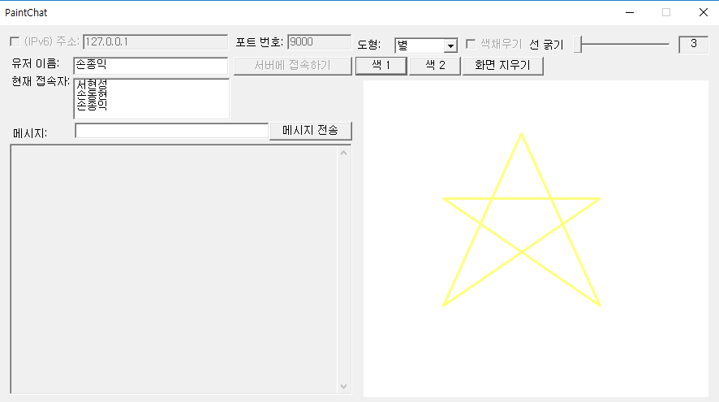
Client
별
case DRAWSTAR:
drawStar(hDC, newLine->x0, newLine->y0, LOWORD(lParam), HIWORD(lParam));
break;
void drawStar(HDC hDC, int x0, int y0, int x1, int y1)
{
MoveToEx(hDC, (unsigned int)(x0 + x1) / 2, y0, NULL);
LineTo(hDC, x0, y1);
MoveToEx(hDC, (unsigned int)(x0 + x1) / 2, y0, NULL);
LineTo(hDC, x1, y1);
MoveToEx(hDC, x0, (unsigned int)((y0 + y1) / 2) - ((y1 - y0) / 8), NULL);
LineTo(hDC, x1, y1);
MoveToEx(hDC, x1, (unsigned int)((y0 + y1) / 2) - ((y1 - y0) / 8), NULL);
LineTo(hDC, x0, y1);
MoveToEx(hDC, x1, (unsigned int)((y0 + y1) / 2) - ((y1 - y0) / 8), NULL);
LineTo(hDC, x0, (unsigned int)((y0 + y1) / 2) - ((y1 - y0) / 8));
}
Made by SJI

Slide 34
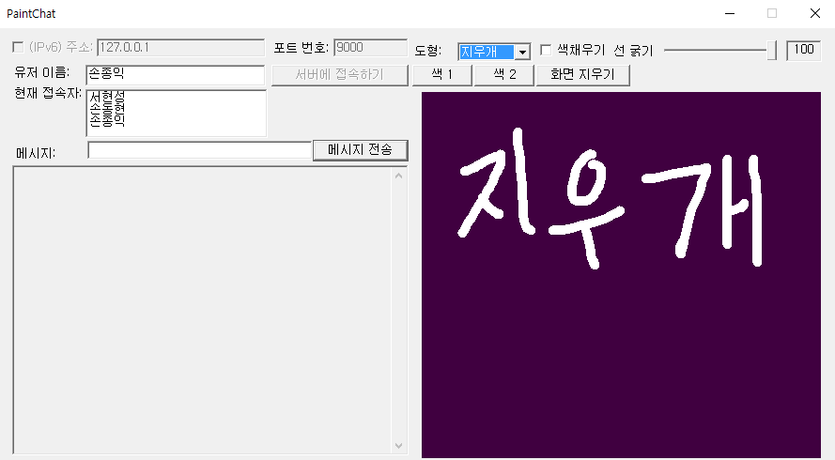
Client
지우개
case DRAWERASER:
hPen = CreatePen(PS_SOLID, 10, RGB(255,255,255));
hOldPen = (HPEN)SelectObject(hDC, hPen);
MoveToEx(hDC, newLine->x0, newLine->y0, NULL);
LineTo(hDC, LOWORD(lParam), HIWORD(lParam));
Made by SJI

Slide 35
